Slide 1



Chapter 7: Basic types
Reading Assignment

Slide 2
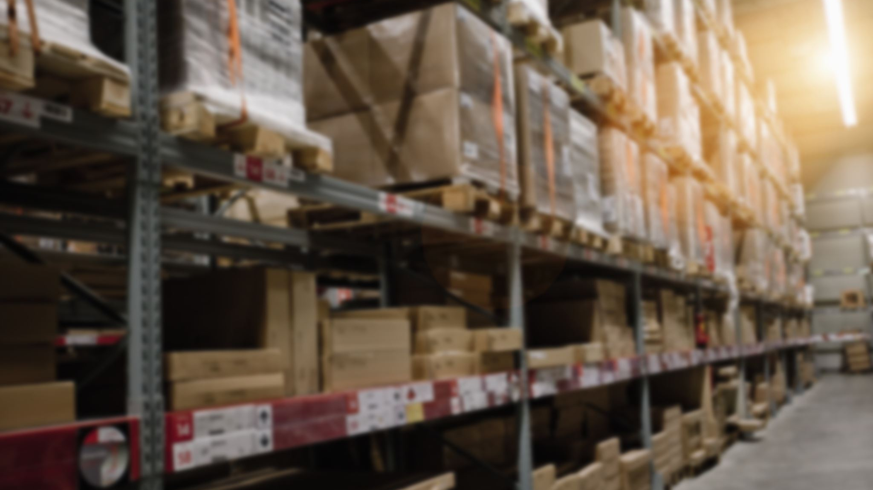
Arrays
HK Rana

Slide 3
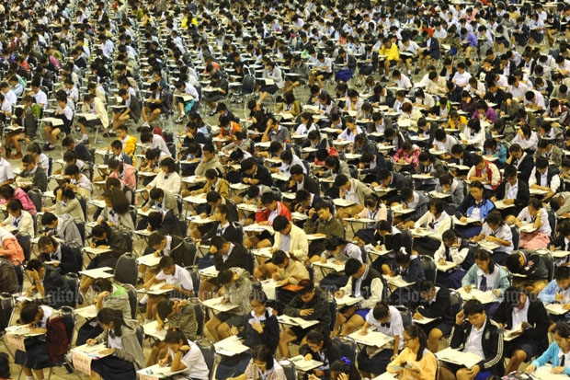
WHY arrays
Need to store a large number of values of an identical data types
For instance:
To store the marks of all the students of a university, you need to declare thousands of variables. In addition, all of them must be unique.
Is this Convenient?

Slide 4
One dimensional arrays
Definition: An array is a data structure containing a number of data values, all of which have the same data type
These values, known as elements, can be individually selected by their position within the array.
Simplest kind of array is One-Dimensional Array
Generally, size of the array is fixed

Slide 5


Array declaration

Slide 6


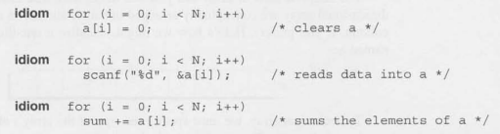
Array subscripting
Note:
Combination of an
Array name and its
Index works like a variable

Slide 7
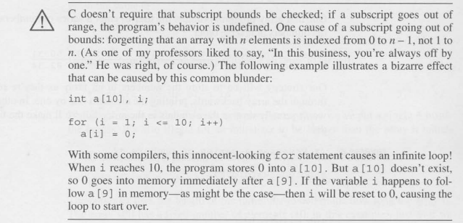
attention

Slide 8
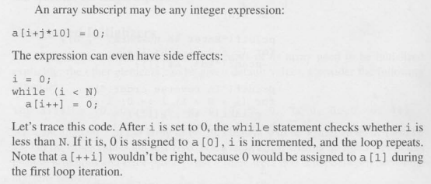
Some more discussions

Slide 9
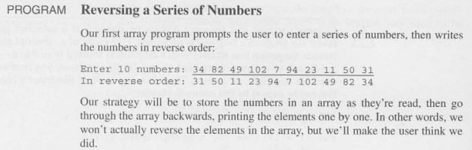
Practice problem 1
Shifting the Array values to one cell right ….

Slide 10

Array initialization

Slide 11
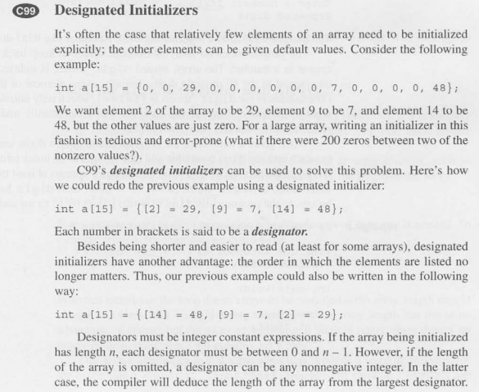
Designated initialization

Slide 12
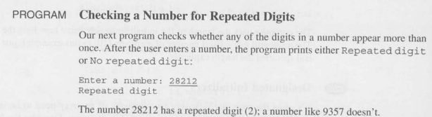
Practice Problem 2

Slide 13
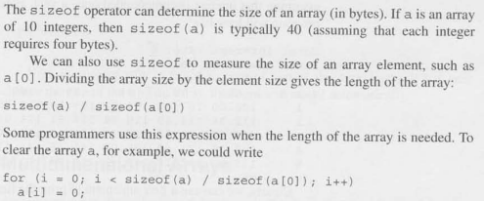
Using the size of operator

Slide 14
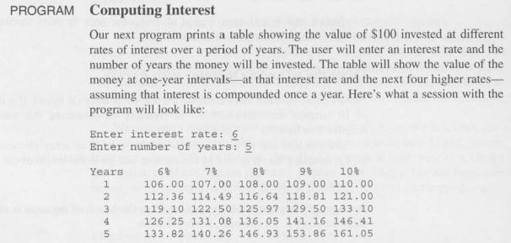
Practice problem 3

Slide 15
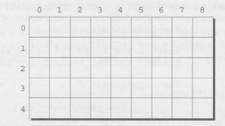

Multidimensional array

Slide 16






Initializing multidimensional array

Slide 17
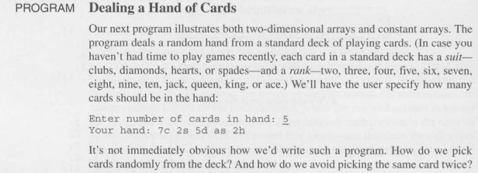
Practice problem 3

Slide 18

Variable length array (C99)

Slide 19
The END

